Slide 1
Recovery System

Slide 2
Storage Structure
Volatile storage:
does not survive system crashes
examples: main memory, cache memory , shared memory
Nonvolatile storage:
survives system crashes
examples: hard disk, tape, flash memory, non-volatile RAM
Stable storage:
A form of storage that survives all failures

Slide 3
Stable-Storage Implementation
Maintain multiple copies of each block on separate disks
copies can be at remote sites to protect against disasters such as fire or flooding.
Failure during data transfer can still result in inconsistent copies: Block transfer can result in
Successful completion
Partial failure: destination block has incorrect information
Total failure: destination block was never updated.
Protecting storage media from failure during data transfer:-
Execute output operation as follows (assuming two copies of each block):
Write the information onto the first physical block.
When the first write successfully completes, write the same information onto the second physical block.
The output is completed only after the second write successfully completes.

Slide 4
Failure Classification
Transaction failure :
Logical errors: transaction cannot complete due to some internal error condition.
System errors: the database system must terminate an active transaction due to an error condition (e.g., deadlock).
System crash: a power failure or other hardware or software failure causes the system to crash.
Fail-stop assumption: non-volatile storage contents are assumed to not be corrupted by system crash
Disk failure: a head crash or similar disk failure destroys all or part of disk storage.

Slide 5
Recovery Algorithms
Recovery algorithms are techniques to ensure database consistency and transaction atomicity and durability despite failures.
Recovery algorithms have two parts:-
Actions taken during normal transaction processing to ensure enough information exists to recover from failures.
Actions taken after a failure to recover the database contents to a state that ensures atomicity, consistency and durability.

Slide 6
Log-Based Recovery
A log is kept on stable storage.
The log is a sequence of log records, and maintains a record of update activities on the database.
When transaction T_{i} starts, it registers itself by writing a <T_{i} start> log record
Before T_{i} executes write(X), a log record <T_{i}, X, V₁, V₂> is written, where V₁ is the value of X before the write, and V₂ is the value to be written to X.
Log record notes that T_{i} has performed a write on data item X_{j} X_{j} had value V₁ before the write, and will have value V₂ after the write.

Slide 7
When T_{i} finishes its last statement, the log record <T_{i} commit> is written.
Two approaches using logs:-
1)Deferred database modification
2)Immediate database modification

Slide 8
(1)Deferred Database Modification
All logs are written on to the stable storage and the database is updated when a transaction commits.
The deferred database modification scheme records all modifications to the log, but defers all the writes to after partial commit.
Assume that transactions execute serially.
Transaction starts by writing <T_{i} start> record to log.
A write(X) operation results in a log record <T_{i}, X, V> being written, where V is the new value for X
Note: old value is not needed for this scheme
The write is not performed on X at this time, but is deferred.
When T_{i} partially commits, <T_{i} commit> is written to the log
Finally, the log records are read and used to actually execute the previously deferred writes.

Slide 9
During recovery after a crash, a transaction needs to be redone if and only if both <T_{i} start> and<T_{i} commit> are there in the log.
Redoing a transaction T_{i} ( redoT_{i}) sets the value of all data items updated by the transaction to the new values.
Crashes can occur while
the transaction is executing the original updates, or
while recovery action is being taken.
example transactions T₀ and T₁ (T₀ executes before T₁):
T₀: read (A) T₁ : read (C)
A: - A - 50 C:-C- 100
Write (A) write (C)
read (B)
B:- B + 50
write (B)

Slide 10
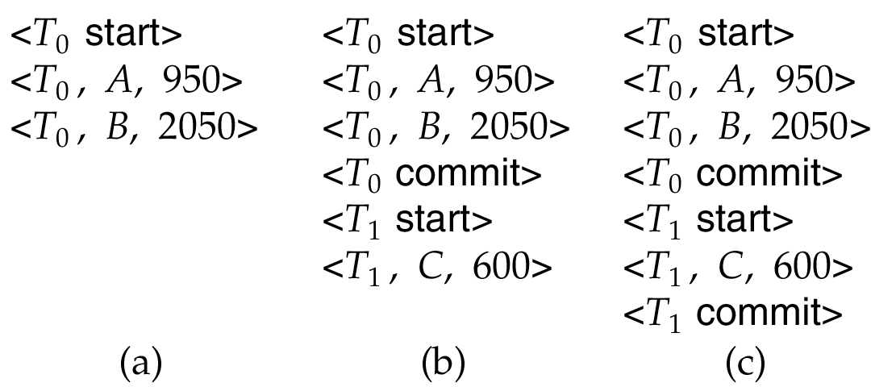
Below we show the log as it appears at three instances of time.
Consider initial value of A=1000,B=2000 C=3000 in DB
If log on stable storage at time of crash is as in case:
(a) No redo actions need to be taken
(b) redo(T₀) must be performed since <T₀ commit> is present
(c) redo(T₀) must be performed followed by redo(T₁) since
<T₀ commit> and <T_{i} commit> are present.

Slide 11
Immediate Database Modification
Each log follows an actual database modification. That is, the database is modified immediately after every operation.
The immediate database modification scheme allows database updates of an uncommitted transaction to be made as the writes are issued
since undoing may be needed, update logs must have both old value and new value.
Update log record must be written before database item is written
We assume that the log record is output directly to stable storage
Can be extended to postpone log record output, so long as prior to execution of an output(B) operation for a data block B, all log records corresponding to items B must be flushed to stable storage.
Output of updated blocks can take place at any time before or after transaction commit
Order in which blocks are output can be different from the order in which they are written.

Slide 12
Recovery procedure has two operations instead of one:
undo(T_{i}) restores the value of all data items updated by T_{i} to their old values, going backwards from the last log record for T_{i}
redo(T_{i}) sets the value of all data items updated by T_{i} to the new values, going forward from the first log record for T_{i.}
Both operations must be idempotent.
That is, even if the operation is executed multiple times the effect is the same as if it is executed once
When recovering after failure:
Transaction T_{i} needs to be undone if the log contains the record <T_{i} start>, but does not contain the record <T_{i} commit>.
Transaction T_{i} needs to be redone if the log contains both the record <T_{i} start> and the record <T_{i} commit>.
Undo operations are performed first, then redo operations.

Slide 13
Immediate Database Modification Example
B_{C} output before T₁ commits
B_{A} output after T₀ commits
Log Write Output
<T₀ start>
<T₀, A, 1000, 950>
<T_{o}, B, 2000, 2050>
A = 950
B = 2050
<T₀ commit>
<T₁ start>
<T₁, C, 700, 600>
C = 600
B_{B} , B_{C}
<T₁ commit>
B_{A}
Note: B_{X} denotes block containing X.

Slide 14
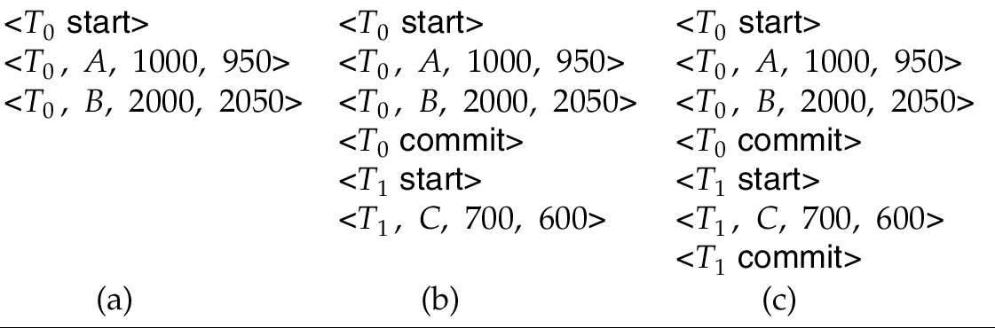
Immediate DB Modification Recovery Example
Below we show the log as it appears at three instances of time.
Recovery actions in each case above are:
(a) undo (T₀): B is restored to 2000 and A to 1000.
(b) undo (T₁) and redo (T₀): C is restored to 700, and then A and B are
set to 950 and 2050 respectively.
(c) redo (T₀) and redo (T₁): A and B are set to 950 and 2050
respectively. Then C is set to 600

Slide 15
Checkpoints
Checkpoint is a mechanism where all the previous logs are removed from the system and stored permanently in a storage disk. Checkpoint declares a point before which the DBMS was in consistent state, and all the transactions were committed.
Problems in recovery procedure :
searching the entire log is time-consuming
we might unnecessarily redo transactions which have already output their updates to the database.
Streamline recovery procedure by periodically performing checkpointing
Output all log records currently residing in main memory onto stable storage.
Output all modified buffer blocks to the disk.
Write a log record < checkpoint> onto stable storage.

Slide 16
During recovery we need to consider only the most recent transaction T_{i} that started before the checkpoint, and transactions that started after T_{i}.
Scan backwards from end of log to find the most recent <checkpoint> record
Continue scanning backwards till a record <T_{i} start> is found.
Need only consider the part of log following above start record. Earlier part of log can be ignored during recovery, and can be erased whenever desired.
For all transactions (starting from T_{i} or later) with no <T_{i} commit>, execute undo(T_{i}). (Done only in case of immediate modification.)
Scanning forward in the log, for all transactions starting from T_{i} or later with a <T_{i} commit>, execute redo(T_{i}).

Slide 17
Example of Checkpoints
T_{checkpoint}
T_{failure}
T₁ can be ignored (updates already output to disk due to checkpoint)
T₂ and T₃ redone.
T₄ undone
T₁
T₂
T₃
T₄
checkpoint
system failure

Slide 18
The recovery system reads the logs backwards from the end to the last checkpoint.
It maintains two lists, an undo-list and a redo-list.
If the recovery system sees a log with <T_{n}, Start> and <T_{n}, Commit> or just <T_{n}, Commit>, it puts the transaction in the redo-list.
If the recovery system sees a log with <T_{n}, Start> but no commit or abort log found, it puts the transaction in undo-list.
All the transactions in the undo-list are then undone and their logs are removed. All the transactions in the redo-list and their previous logs are removed and then redone before saving their logs.

Slide 19
Checkpoints are performed as before, except that the checkpoint log record is now of the form < checkpoint L> where L is the list of transactions active at the time of the checkpoint
We assume no updates are in progress while the checkpoint is carried out.
When the system recovers from a crash, it first does the following:
Initialize undo-list and redo-list to empty
Scan the log backwards from the end, stopping when the first <checkpoint L> record is found. For each record found during the backward scan:
if the record is <T_{i} commit>, add T_{i} to redo-list
if the record is <T_{i} start>, then if T_{i} is not in redo-list, add T_{i} to undo-list
For every T_{i} in L, if T_{i} is not in redo-list, add T_{i} to undo-list

Slide 20
Example of Recovery
Go over the steps of the recovery algorithm on the following log:
<T₀ start>
<T₀, A, 0, 10>
<T₀ commit>
<T₁ start> --stop backward for undo
<T₁, B, 0, 10>
<T₂ start>
<T₂, C, 0, 10>
<T₂, C, 10, 20>
<checkpoint {T₁, T₂}> -- start forward for redo
<T₃ start>
<T₃, A, 10, 20>
<T₃, D, 0, 10>
<T₃ commit>

Slide 21
Summary-Checkpoint
Keeping and maintaining logs in real time and in real environment may fill out all the memory space available in the system.
As time passes, the log file may grow too big to be handled at all.
Checkpoint is a mechanism where all the previous logs are removed from the system and stored permanently in a storage disk.
Checkpoint declares a point before which the DBMS was in consistent state, and all the transactions were committed.

Slide 22
Shadow Paging
Shadow paging is an alternative to log-based recovery; this scheme is useful if transactions execute serially.
Idea: maintain two page tables during the lifetime of a transaction –the current page table, and the shadow page table
Store the shadow page table in nonvolatile storage, such that state of the database prior to transaction execution may be recovered.
Shadow page table is never modified during execution
To start with, both the page tables are identical. Only current page table is used for data item accesses during execution of the transaction.
Whenever any page is about to be written for the first time
A copy of this page is made onto an unused page. [to be a new current page]
The current page table is then made to point to the copy
The update is performed on the copy

Slide 23
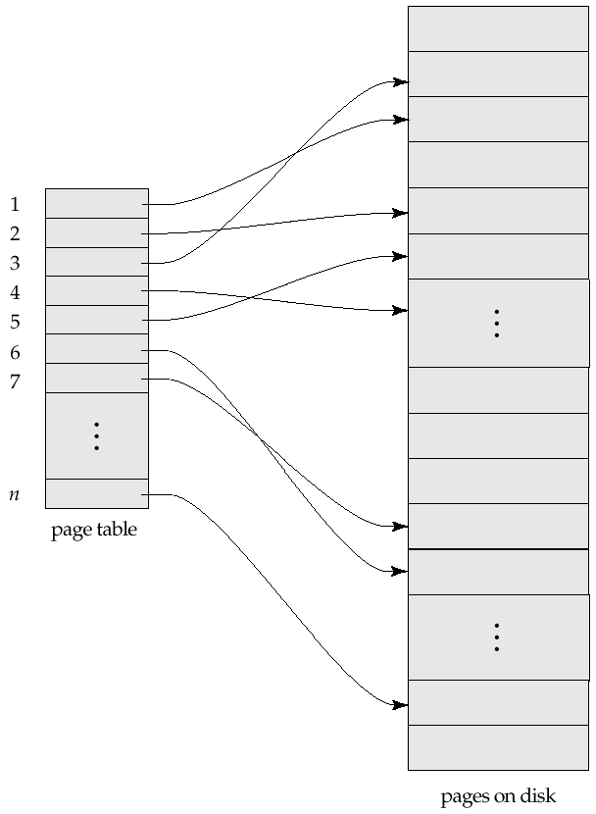
Sample Page Table

Slide 24
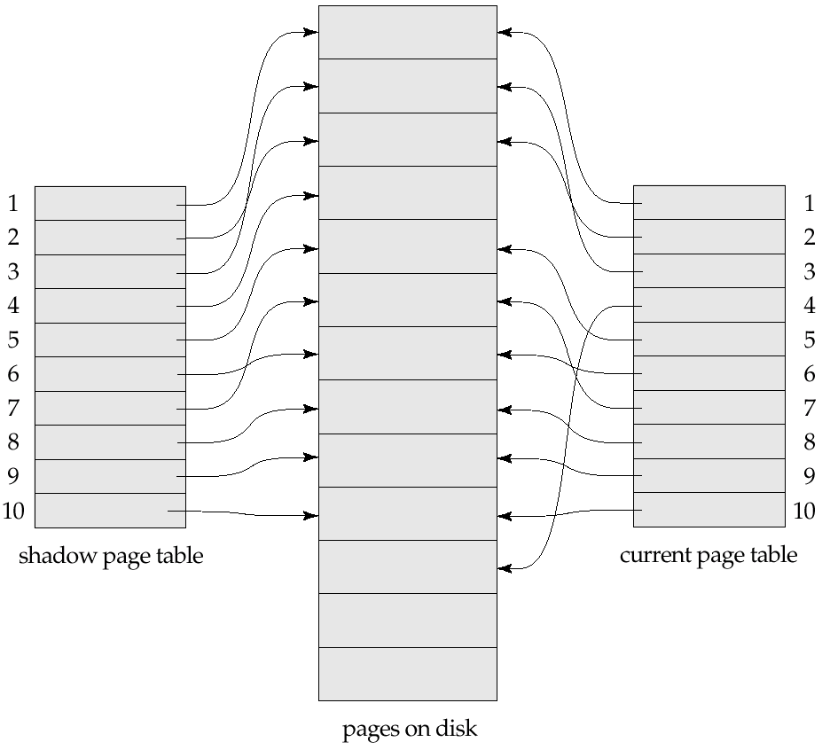
Example of Shadow Paging
Shadow and current page tables after write to page 4

Slide 25
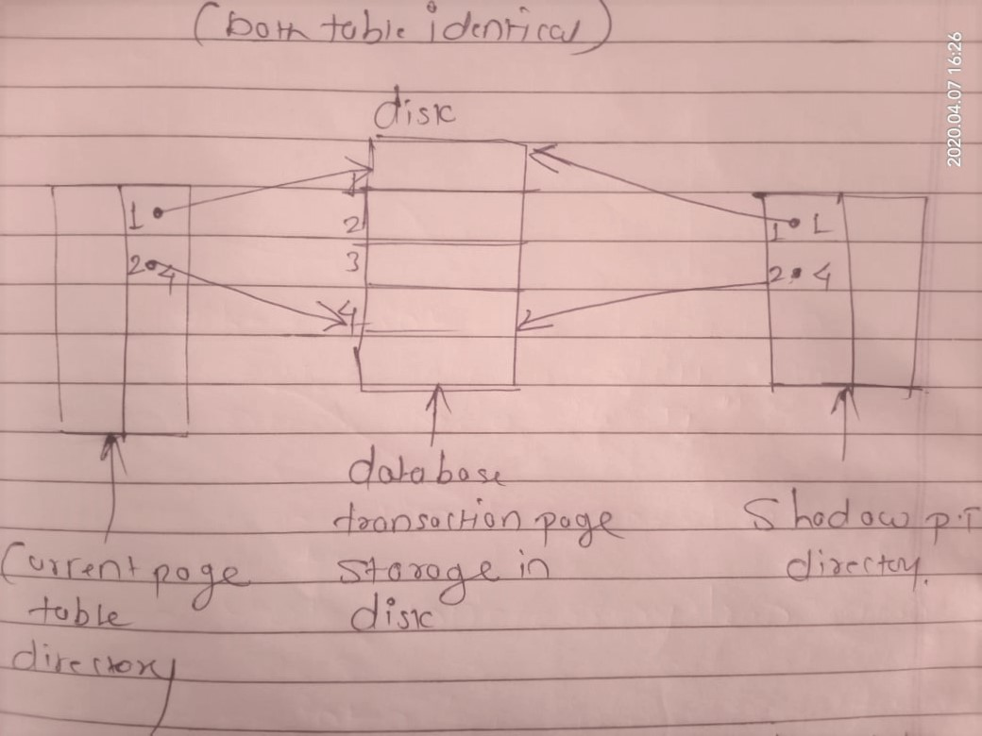
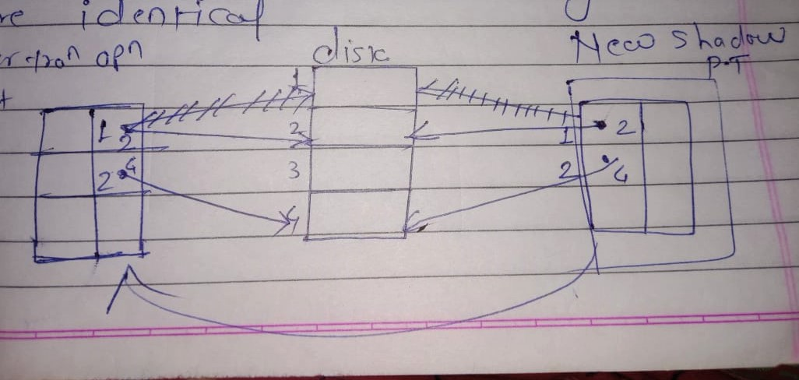

Slide 26
To commit a transaction :
1. Flush all modified pages in main memory to disk
2. Output current page table to disk
3. Make the current page table the new shadow page table, as follows:
keep a pointer to the shadow page table at a fixed (known) location on disk.
to make the current page table the new shadow page table, simply update the pointer to point to current page table on disk
Once pointer to shadow page table has been written, transaction is committed.
No recovery is needed after a crash — new transactions can start right away, using the shadow page table.
Pages not pointed to from current/shadow page table should be freed (garbage collected).

Slide 27
Advantages of shadow-paging over log-based schemes
no overhead of writing log records
recovery is trivial-(No undo or redo ) directly replacing the page
Disadvantages :
Copying the entire page table is very expensive
Commit overhead is high.
Need to flush every updated page, and page table
For single transaction (actual block address, current P.T, Disk address of C.P.T)
Data gets fragmented (related pages get separated on disk)
After every transaction completion, the database pages containing old versions of modified data need to be garbage collected.

Slide 28
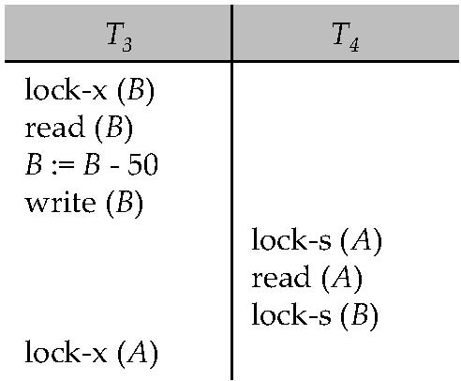
Deadlocks
Consider the partial schedule
Neither T₃ nor T₄ can make progress — executing lock-S(B) causes T₄ to wait for T₃ to release its lock on B, while executing lock-X(A) causes T₃ to wait for T₄ to release its lock on A.
Such a situation is called a deadlock.
To handle a deadlock one of T₃ or T₄ must be rolled back and its locks released.

Slide 29
Two-phase locking does not ensure freedom from deadlocks.
In addition to deadlocks, there is a possibility of starvation.
Starvation occurs if the concurrency control manager is badly designed. For example:
A transaction may be waiting for an X-lock on an item, while a sequence of other transactions request and are granted an S-lock on the same item.
The same transaction is repeatedly rolled back due to deadlocks.
Concurrency control manager can be designed to prevent starvation.

Slide 30
The potential for deadlock exists in most locking protocols.
When a deadlock occurs there is a possibility of cascading roll-backs.
Cascading roll-back is possible under two-phase locking. To avoid this, follow a modified protocol called strict two-phase locking -- a transaction must hold all its exclusive locks till it commits/aborts.
Rigorous two-phase locking is even stricter. Here, all locks are held till commit/abort. In this protocol transactions can be serialized in the order in which they commit.

Slide 31
Deadlock Detection
Deadlocks can be described as a wait-for graph, which consists of a pair G = (V,E),
V is a set of vertices (all the transactions in the system)
E is a set of edges; each element is an ordered pair T_{i} →T_{j}.
If T_{i} → T_{j} is in E, then there is a directed edge from T_{i} to T_{j}, implying that T_{i} is waiting for T_{j} to release a data item.
When T_{i} requests a data item currently being held by T_{j}, then the edge T_{i} → T_{j} is inserted in the wait-for graph. This edge is removed only when T_{j} is no longer holding a data item needed by T_{i}.
The system is in a deadlock state if and only if the wait-for graph has a cycle. Must invoke a deadlock-detection algorithm periodically to look for cycles.

Slide 32
Deadlock Detection (Cont.)
Wait-for graph without a cycle
Wait-for graph with a cycle

Slide 33
Deadlock Recovery
When deadlock is detected :
Some transaction will have to rolled back (made a victim) to break deadlock. Select that transaction as victim that will incur minimum cost.
Rollback -- determine how far to roll back transaction
Total rollback: Abort the transaction and then restart it.
More effective to roll back transaction only as far as necessary to break deadlock.
Starvation happens if same transaction is always chosen as victim. Include the number of rollbacks in the cost factor to avoid starvation.

Slide 34
Deadlock Handling
System is deadlocked if there is a set of transactions such that every transaction in the set is waiting for another transaction in the set.
Deadlock prevention protocols ensure that the system will never enter into a deadlock state. Some prevention strategies :
Require that each transaction locks all its data items before it begins execution (predeclaration).
Impose partial ordering of all data items and require that a transaction can lock data items only in the order specified by the partial order.

Slide 35
More Deadlock Prevention Strategies
Following schemes use transaction timestamps for the sake of deadlock prevention alone.
wait-die scheme — non-preemptive
older transaction may wait for younger one to release data item. (older means smaller timestamp).
Younger transactions never wait for older ones; they are rolled back instead.
a transaction may die several times before acquiring needed data item
wound-wait scheme — preemptive
older transaction wounds (forces rollback) of younger transaction instead of waiting for it. Younger transactions may wait for older ones.
may be fewer rollbacks than wait-die scheme.

Slide 36
Both in wait-die and in wound-wait schemes, a rolled back transactions is restarted with its original timestamp. Older transactions thus have precedence over newer ones, and starvation is hence avoided.
Timeout-Based Schemes:
a transaction waits for a lock only for a specified amount of time. If the lock has not been granted within that time, the transaction is rolled back and restarted,
Thus, deadlocks are not possible
simple to implement; but starvation is possible. Also difficult to determine good value of the timeout interval.

Slide 37
References
https://www.db-book.com › slide-dir
Sixth Edition Avi Silberschatz Henry F. Korth
S. Sudarshan
Book-Database System Concepts.

Slide 38
END

